Slide 1
IMMUNITY
RUNGTA COLLEGE OF DENTAL SCIENCES AND RESEARCH,BHILAI
PRESENTED BY:
Dr Sonika Bodhi
Reader
Dept. of Periodontology

Slide 2
SPECIFIC LEARNING OBJECTIVES
CORE AREAS | DOMAIN | CATEGORY
B cells and Antibodies: Types and Functions | COGNITVE | MUST TO KNOW
MHC molecules | COGNITVE | NICE TO KNOW
Antigen presenting cells | COGNITVE | MUST TO KNOW
T cells | COGNITVE | MUST TO KNOW

Slide 3
CONTENTS- PART I
Introduction
Definition
Classification of immune response
Organs of immune system
Cells of immune system
Innate immune system
Complement system
Neutrophils
Summary
References

Slide 4
CONTENTS- PART II
Adaptive immune system
B cells and Antibodies: Types and Functions
MHC molecules
Antigen presenting cells
T cells
Summary
References

Slide 5
ADAPTIVE IMMUNITY
It is the defense mechanisms that can recognize and destroy specific substances.
Once a foreign organism is identified by the innate immune system, circulating T-cells begin interacting with foreign antigen. Based on their encounter, they can do one of three things:
they can kill infected cells directly, they can boost the actions of macrophages to kill infected cells, or
Notes:
Adaptive immunity is stimulated by the generic actions of innate immunity

Slide 6
ADAPTIVE IMMUNITY
they can return to lymph tissue to incite a B cell response.
Stimulated B cells will proceed to produce antibody, which can then circulate to fight the infection.

Slide 7
ADAPTIVE IMMUNITY
Four phases are involved in the generation of specific immunity:
Clonal selection, the selection of lymphocytes that bear receptors (BCRs or TCRs) recognizing the specific antigen.
Clonal expansion, the proliferation of those lymphocytes;
Clonal contraction, the death of “effector” lymphocytes;

Slide 8
ADAPTIVE IMMUNITY
4) Memory, the maintenance of an expanded clone of cells that bears the specific receptors (BCRs or TCRs) recognizing the antigen.
As long as a sufficient number of lymphocytes are maintained to provide protection against a specific antigen, the individual is said to be “immune.”

Slide 9
Antigen
Antigen
Term coined by Ladislas Deutsch in 1903
‘an antigen (Ag), or antibody generator, is any substance which provokes an specific immune response’.

Slide 10
ANTIBODY
Term coined by Paul Ehrlich in late 19th century
Antibodies are proteins……..Heidelberger
‘an immunoglobulin protein molecule synthesized on exposure to antigen that can combine specifically with that antigen’.

Slide 11
Structure of Antibodies
Each antibody molecule consists of two identical short polypeptides, called light chains, and two identical long polypeptides, called heavy chains. The four chains in an antibody molecule are held together by disulfide (—S—S—) bonds, forming a Y-shaped molecule.

Slide 12
Structure of Antibodies

Slide 13
Structure of Antibodies
The N terminal half of the H-chain and all of the L-chain together make up a Fab fragment and contains the antigen-binding site.
C terminal half of the H-chain, termed as the Fc region do not bind antigen, but rather determine the ‘biological’ properties of the molecule

Slide 14
Structure of Antibodies
There are five different kinds of H-chains (referred to as μ, δ, γ, ε and α chains), which determine the class of antibody (IgM, IgD, IgG, IgE and IgA, respectively).

Slide 15
ANTIBODY DIVERSITY

Slide 16
ANTIBODY DIVERSITY
After encountering an antigen, and in the presence of costimulatory signals, the B cell further differentiates into a plasma cell, which secretes high levels of the specific antibody or into a memory B cell.

Slide 17
B CELL ACTIVATION
Two B cell groups can be distinguished based on their requirement for T cell help in order to proliferate and differentiate.
B2 cells eventually give rise to plasma cells that produce IgG, IgA and IgE antibodies.
B1
B2
T-cell-independent (T-I)
T-cell-dependent (T-D)

Slide 18
B CELL ACTIVATION
T cell-dependent activation:
Co-stimulatory signal involves direct contact between a B cell and a helper T (Th) cell. On the surface of activated Th cells are proteins called CD40L. When CD40L plugs into (ligates) a protein called CD40 on the surface of a B cell, the co-stimulatory signal is sent, and if the B cell’s receptors have been crosslinked, the B cell is activated.

Slide 20
B CELL ACTIVATION
T cell-independent activation
B cells can also respond to some antigens that have numerous repeating epitopes (mainly polysaccharides) that bind multiple B-cell receptors and activate the B cell directly to secrete IgM antibody.
Notes:
However, as there is no germinal centre formation, no affinity maturation takes place, and there is no class switching or generation ofmemory. Therefore T-cell independent responses are IgM limited, of poor specificity, and short lived.

Slide 22
T CELL
Cannot recognise antigen in solution
Must have the antigen processed and presented to it via Antigen Presenting Cells.
Specialised molecules present antigens to T cells: MHC molecules

Slide 23
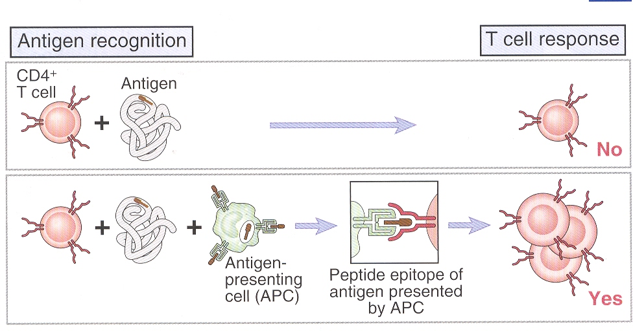
T CELL

Slide 24
Antigen-presenting cells
When a foreign particle, such as a virus, infects the body, it is taken in by cells and partially digested. Within the cells, the viral antigens are processed and moved to the surface of the plasma membrane. The cells that perform this function are known as antigen-presenting cells.
At the membrane, the processed antigens are complexed with the MHC proteins. This enables T cells to recognize antigens presented to them associated with the MHC proteins.

Slide 26
Antigen-presenting cells
3 types of Antigen presenting cells:
Macrophages
Dendritic cells
B cells

Slide 27
Major Histocompatibility Complex (MHC) Molecules
Cytotoxic T lymphocytes, which act to destroy infected cells can only interact with antigens presented to them with MHC-I proteins.
Helper T lymphocytes, can interact only with antigens presented with MHC-II proteins

Slide 28
Major Histocompatibility Complex (MHC) Molecules

Slide 29
T cell activation
Signaling by means of the antigen receptors alone, does not activate lymphocytes.
Instead, such isolated signals lead to anergy or apoptosis.
The additional signals required for the activation of lymphocytes come from various costimulatory molecules on the surface of neighboring cells and soluble mediators such as cytokines.

Slide 30
T cell activation
Molecules on the surface of T cells that bind to costimulatory molecules on antigen-presenting cells include CD28, whose ligand is B7; CD154, which binds to CD40; and CD2, the ligand for CD58.
Essentially, the molecules constitute receptor–ligand pairs that are required for activating and regulating lymphocytes.
Activated dendritic cells are particularly potent stimulators of naive T cells, because they express large amounts of the costimulatory B7 and CD40 molecules

Slide 31
T cell differentiation
After initial antigenic activation, naïve T-cells develop into an intermediate stage cell called the T_{H}0 cell which can then be activated by any antigen-presenting cell, e.g. Dendritic cells, macrophages or B cells.

Slide 32
T cell differentiation
Early inflammatory signals from macrophages and peripheral dendritic cells such as interleukin-1β(IL-1β) activate the CD4+ T-helper (Th) T cell.
The Th cell then produces many cytokines, including IL-2, interferon-γ (IFN-γ) and IL-4, and is referred to as a Th0 T cell.

Slide 33
T cell differentiation
The Th0 T cell further differentiates to form Th1 or Th2 T cells, which regulate immune responses against intracellular and extracellular antigens, respectively.
A key signal determining which pathway the T cell follows is the level of IL-12 provided by the antigen-presenting cell.
High levels of IL-12 favor the Th1 pathway, and low levels of IL-12 favor the Th2 pathway.

Slide 35
SUMMARY
The immune system is composed of the lymphatic system, blood proteins (known as immunoglobulins), specialized white blood cells such as lymphocytes, as well as the organs that produce these cells and the blood vessels that transport them. All are designed to react rapidly to disease-producing organisms and their toxins.

Slide 36
REFERENCES

